Slide 1
CDA 3101 Spring 2016
Introduction to Computer Organization
Introduction
Tue 05 Jan 2016
Mark Schmalz
http://www.cise.ufl.edu/~mssz/CompOrg/Top-Level.html

Slide 2
Overview
Introduction to CDA 3101
Course overview
Housekeeping details
Computer abstraction
Anatomy of a computer
Conclusion

Slide 3
Introduction
Rapidly changing field:
  vacuum tube -> transistor -> IC -> VLSI (see Section 1 of text)
  doubling every 1.5 years (Moore’s law):
    Memory capacity
    Processor speed (Due to advances in technology and organization)
Things you’ll be learning:
  how computers work, a basic foundation
  how to analyze their performance (or how not to!)
  issues affecting modern processors (caches, pipelines)
Why learn this stuff?
  you want to call yourself a “computer scientist”
  you want to build software people use (need performance)
  you need to make a purchasing decision or offer advice

Slide 4
Computing System
Application (Browser)
Operating
Compiler
System
(Win, Linux)
CDA 3101
Software
Assembler
Instruction Set
Architecture
Hardware
Processor
Memory
I/O system
Datapath & Control
Digital Design
Circuit Design
transistors
Coordination of many levels of abstraction

Slide 5
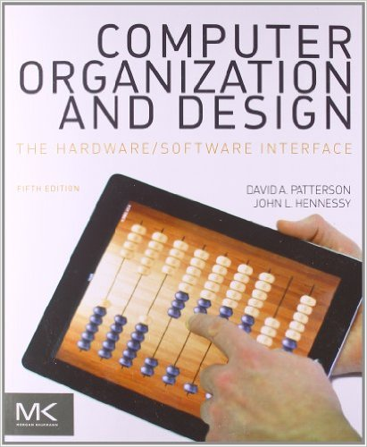
CDA 3101 Textbook
Textbook: “P&H”
Computer Organization and Design
Patterson and Hennessy
Fifth Edition
Morgan Kaufmann
© 2014
ISBN: 9780124077263

Slide 6
Course Overview
Performance issues (Ch 1 – P&H 5th Edition)
A specific instruction set architecture (Ch 2)
Arithmetic and how to build an ALU (Ch 3)
Constructing a processor to execute our instructions (Ch 4)
Pipelining to improve performance (Ch 4)
Caches, main, and virtual memory, I/O (Ch 5)
Multiprocessor Architectures (Ch 6)
Future Computing Technologies (instructor)

Slide 7
CDA 3101 Big Ideas
5 Classic components of a Computer
Data can be anything (integers, floating point, characters): a program determines what it is
Stored program concept: instructions just data
Principle of Locality, exploited via a memory hierarchy (cache and virtual memory)
Greater performance by exploiting parallelism
Principle of abstraction, used to build complex systems as layers
Compilation v. interpretation thru system layers
Principles/Pitfalls of Performance Measurement

Slide 8
Course Administration
Instructor:
  Dr. Schmalz (mssz@cise.ufl.edu, CSE 446, 352-505-1561)
TAs:
  TBD email@cise.ufl.edu
  TBD email@cise.ufl.edu
  TBD email@cise.ufl.edu
Web site: www.cise.ufl.edu/~mssz/CompOrg/Top-Level.html
Canvas site is in progress
Text: Computer Organization and Design: The Hardware Software Interface, Fifth Edition, Patterson and Hennessy

Slide 9
Course Evaluation
Grade breakdown
  Midterm Exam (2) 40% 420 points
  Final Exam 25% 240 points
  Quizzes (5) 10% 100 points
  Homework Assignments (5) 25% 240 points
  TOTAL 100% 1000 points
Scores posted on Canvas site (as available)
  Grade changes: Work with TA
  Fri 25 Apr 2016 deadline to correct online scores
No Cheating – No Curving in this Course

Slide 10
Levels of Representation
temp = v[k];
v[k] = v[k+1];
v[k+1] = temp;
High Level Language Program (e.g., C)
CDA3101
Compiler
lw $t0, 0($2)
lw $t1, 4($2)
sw $t1, 0($2)
sw $t0, 4($2)
Assembly Language Program (e.g.,MIPS)
Assembler
Machine Language Program (MIPS)
0000 1001 1100 0110 1010 1111 0101 1000
1010 1111 0101 1000 0000 1001 1100 0110
1100 0110 1010 1111 0101 1000 0000 1001
0101 1000 0000 1001 1100 0110 1010 1111
Machine Interpretation
Control Signal Specification
°
°

Slide 11
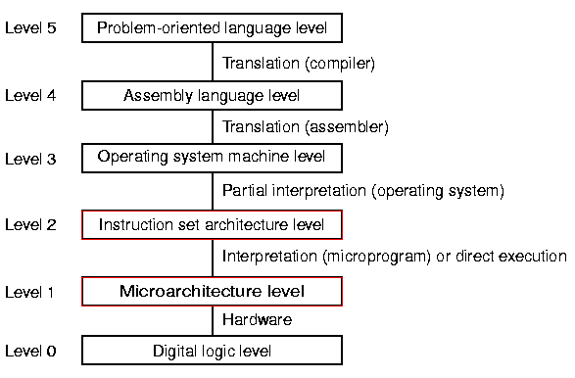
A Six-Level Computer

Slide 12
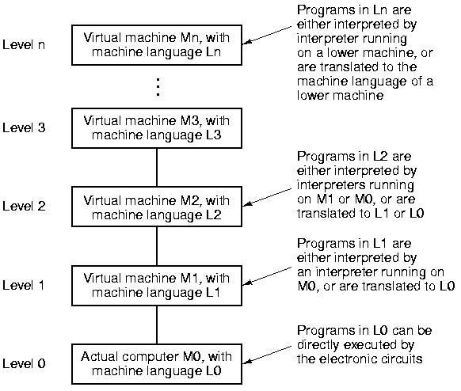
Big Idea: Multilevel Machine

Slide 13
Evolution of Multilevel Machines
Bare hardware
Microprogramming
Operating system
Compilers
Hardware / software interface
  Simple ISA
  CISC
  RISC
  FISC

Slide 14
Design Principles
CISC vs. RISC
Instructions directly executed by hardware
Maximize instruction issue rate (ILP)
Simple instructions (easy to decode)
Access to memory only via load/store
Plenty of registers
Pipelining

Slide 15
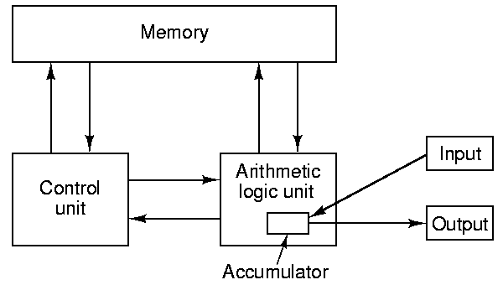
Computer Organization
Von Neumann Machine
Processor

Slide 16
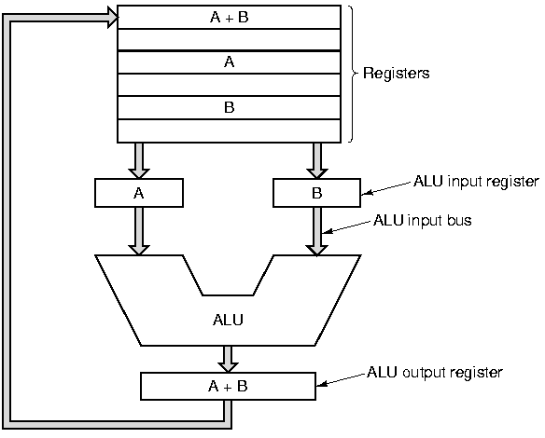
Datapath
Memory
I/O

Slide 17
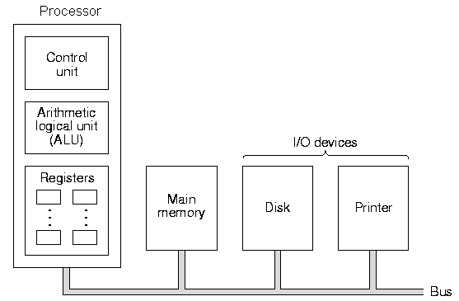
Bus-Based Computer

Slide 18
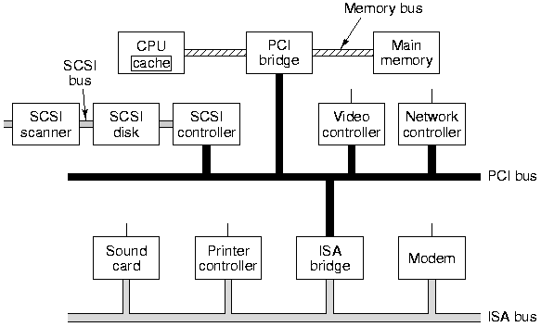
Anatomy of a Modern PC

Slide 19
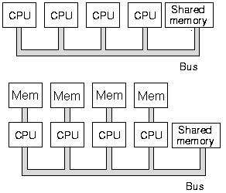
Multiprocessors
Local Memory

Slide 20
Conclusion
< 16 weeks to learn big ideas in CS/CEN
  Principle of abstraction, used to build systems as layers
  Pliable Data: a program determines what it is
  Stored program concept: instructions are just data
  Principle of Locality, exploited via memory hierarchy
  Greater performance by exploiting parallelism (pipeline)
  Compilation v. interpretation to move downward through layers of system
  Principles/Pitfalls of Performance Measurement

